Slide 1
Pointers
Creative Commons Attribution-NonCommercial-ShareAlike 3.0 Unported License. http://creativecommons.org/licenses/by-nc-sa/3.0/
Written by Rachel J. Morris, last updated 2016-02-14

Slide 2

Memory Addresses

Slide 3

Memory Addresses
When we declare a variable, a set amount of memory is set aside to store the value of that variable.
Different data types need different amounts of memory.
Characters and Booleans take 1 byte (8 bits),
Integers and floats take 4 bytes,
And Doubles take 8 bytes.
20
4 bytes

Slide 4
Memory Addresses
When we set aside memory for a variable, that means we also reserve a memory address for that item.
A memory address looks like a hexadecimal number.
Address:
0x7fff957449bc
20
4 bytes

Slide 5
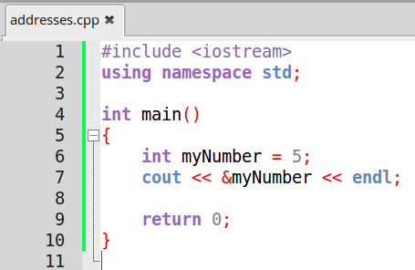
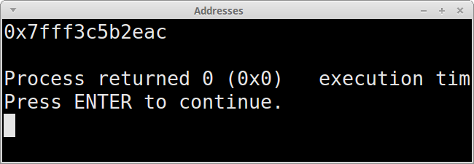
Memory Addresses
In C++, you can view a variable's memory address by using the
address-of operator & , which prepends the variable's name.
Where else have we seen &?
When we pass something by reference!
20

Slide 6
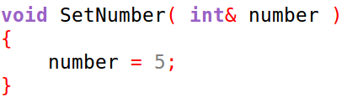
Memory Addresses
Passing a parameter by-reference with the
reference operator
Take note of the different ways we can use the &.
When passing by reference, the & goes between the data type and the parameter name.
When getting the address of, we use it before the variable name.
Outputting the address of a variable with the
address-of operator
20

Slide 7
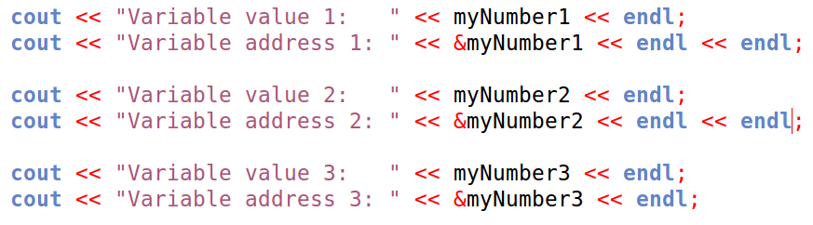
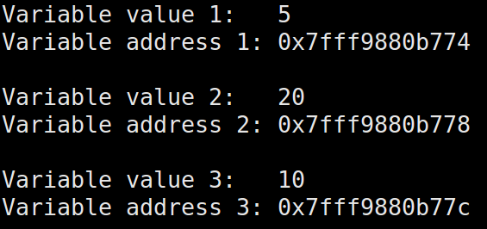
Memory Addresses
Every variable has its own memory address.
Since we can obtain a variable's memory address,
we can also store that memory address in a variable.
That's where pointers come in...

Slide 8
Pointers

Slide 9
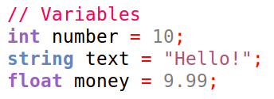
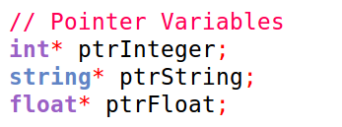
Pointers
We may want to create a variable that stores the memory address of another variable.
These variables are called pointers,
and are very important in C++.
A pointer variable is denoted with an asterisk, *
which does not mean multiplication here.
20
*

Slide 10
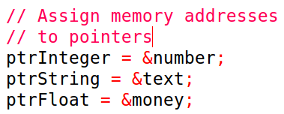
Pointers
We can assign the value of a pointer variable to the memory address of a different variable (of the same base type) by using the address-of operator &
Note that after we declare a pointer of some data-type*, we don't use that asterisk when we're assigning data to the pointer.
20
*

Slide 11
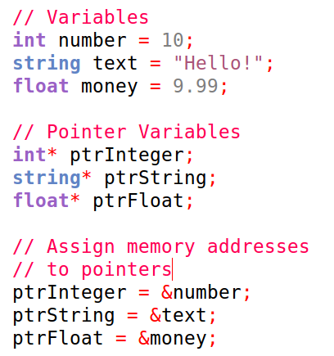
Pointers
Remember:
Declare a pointer with data-type*
Assign a pointer to an address with
&variableName
The challenging part about pointers is keeping these operators straight, so make an effort to look over it and they won't cause you too much trouble!
*

Slide 12
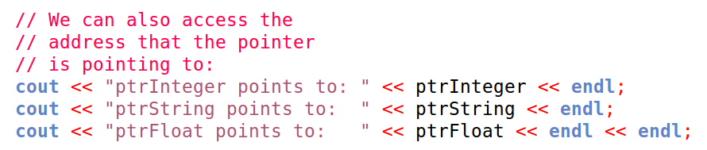
Pointers
After we've assigned our pointers to memory addresses,
we can view the memory address that a pointer is pointing to,
by simply accessing that pointer directly.
Remember:
Direct access to a pointer gives you the memory address of the variable it is pointing to.
*

Slide 13
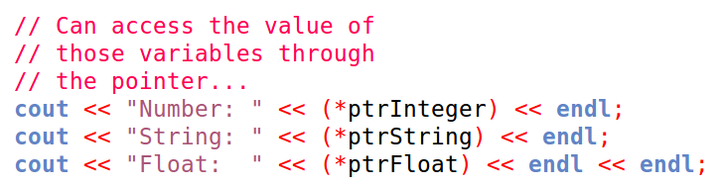
Pointers
If we want to access the value of the pointed-to variable,
we need to prepend * to the pointer variable.
In this context, it is the de-reference operator.
Remember:
Prepending a * to a pointer gives you the value of the pointed-to variable.
*

Slide 14


Pointers
We can use this either get the value of the pointed-to variable,
or set the value of the pointed-to variable.
Remember:
Prepending a * to a pointer gives you the value of the pointed-to variable.
*

Slide 15
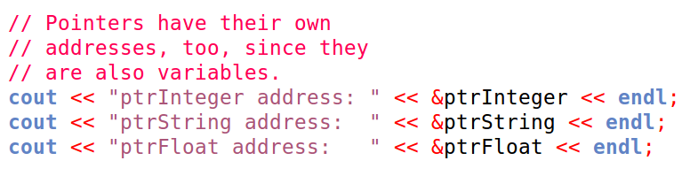
Pointers
Finally, remember that pointers are variables themselves,
and also have their own memory addresses.
The address of the pointer is the address of the actual pointer variable.
*

Slide 16
Pointers
The address of the pointer is the address of the actual pointer variable.
The value of the pointer is the address of the pointed-to variable.
*
Keep these straight!

Slide 17
Time to review!

Slide 18



Seriously,
memorize this stuff.
Review!
#1: Prepend & (address-of operator) to a variable name to get its memory address
#2: Pointer variables are declared by adding a * between the data-type and the variable name.
#3: We can assign a pointer variable the address of
another variable (of same data-type) using the address-of operator &

Slide 19

Review!
Seriously,
memorize this stuff.
#4: Direct access to a pointer gives you the memory address of the variable it is pointing to.
#5: Prepending a * (dereference operator) to a pointer gives you the value of the pointed-to variable.

Slide 20
Review!
Seriously,
memorize this stuff.
#4: Direct access to a pointer gives you the memory address of the variable it is pointing to.
#5: Prepending a * (dereference operator) to a pointer gives you the value of the pointed-to variable.
#6: Prepending a * (dereference operator) to a pointer
gives also will allow us to set the value of the pointed-to variable.

Slide 21
Sample Program

Slide 22
new and delete

Slide 23
new and delete
We can use pointers to create variables as well.
This will come in handy once we're working with dynamic arrays
and building our own data structures.
The new keyword allows us to allocate memory,
and the delete keyword will free that memory.
Therefore, any time you call new, you should also call delete.

Slide 24
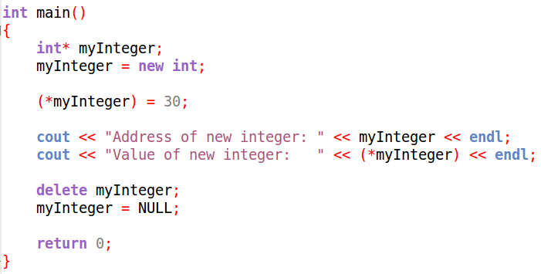

new and delete
When you create a new variable in this manner, you still need to follow the rules of pointers –
you can only access the variable's value by using the de-reference operator *

Slide 25
new and delete
If you neglect to call delete to correspond to a new,
you will create a memory leak.
Each time your program is run, it will allocate memory, but never free it.
To regain the lost memory, you would have to restart your computer.

Slide 26
new and delete
After you free the memory that a pointer is pointing to,
it is also good practice to reassign the pointer to the value of NULL.
Otherwise, it will still be pointing at a memory address,
and could cause an access error, because that memory could be reused by another program after it has been freed by your program!!

Slide 27
Pointers as Parameters

Slide 28
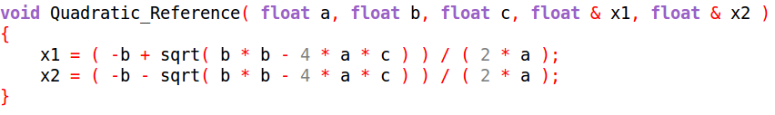

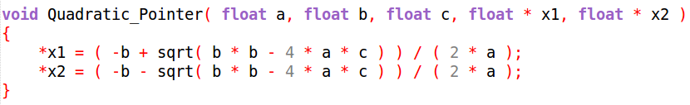

Pointers as Parameters
Up until now, we've passed variables by-reference in order to return multiple values from a function, or to optimize our program by avoiding the copying of objects.
We can do the same with pointers, by passing memory addresses:

Slide 29
Pointers as Parameters
When you utilize pointers in this way, there are more steps to remember than with simply passing variables by reference.
A: Make sure your parameters are pointers.
C: Make sure to pass the addresses of the variables in question using
the address-of operator.
B: Make sure to
de-reference the pointer parameters when assigning values to them.
A
B
C

Slide 30

Pointers as Parameters
For the most part, it is simpler to stick to passing parameters as references.

Slide 31
Pointers as return types

Slide 32
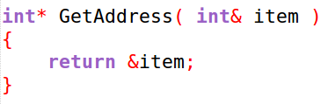

Pointers as return types
We can also return a pointer from a function,
we just need to make sure to set the return type to a pointer.
We store the result in a pointer variable as well.

Slide 33
Pointers of Objects

Slide 34
Pointers of Objects
We can also use pointers to point to variables that are types objects –
classes and structs.
Our objects may have member functions and/or variables,
so if we need to use * to dereference a normal variable to get its value,
how do we dereference an object to get to its members?

Slide 35


Pointers of Objects
We can use the dereference operator in order to access members of an object,
however, note that you will need to surround the
dereference operator and the pointer name with parenthesis:
The following will not work, due to C++'s order of operations:

Slide 36

Pointers of Objects
You can also use the member access operator ->
as a shortcut, instead of wrapping the dereference and pointer name in parenthesis:
You can use this with both member functions and member variables.
It is more standard to see -> used.

Slide 37
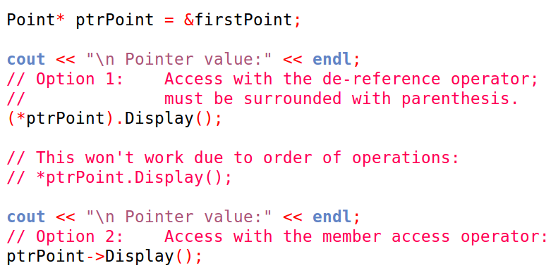
Pointers of Objects

Slide 38
Finally...

Slide 39

We have a lot more to cover with pointers and this is just the beginning.
Next up is memory management, and creating dynamically sized arrays.
And later on, we will be writing data structures, that contain pointers and manipulate memory.
As always, make sure to practice!

Slide 40
Program with Pointers

Slide 41
Sample Programs...
A. Students
B. Game rooms

Slide 42
Sample Programs...
A. Students
B. Game rooms

Slide 43
Sample Programs...
A. Students
B. Game rooms

